Slide 1

Machine Learning based Diagnostic System for Sleep Disorder
PROJECT BATCH:B2
PROJECT MEMBERS:
R.Premonvitha Sai (20-4244)
Y.P.V.Bhargavi (20-4262)
A.Maanvitha (20-4203)
K.N.V.Sahithi (20-4223)
PROJECT GUIDE: Guided by : Mr. Dr. M R K Krishna Rao Professor, Department of CSE(AI & ML), GVPCEW
Department of Computer Science and Engineering(AI&ML)
GAYATRI VIDYA PARISHAD COLLEGE OF ENGINEERING FOR WOMEN
[Approved by AICTE NEW DELHI, Affiliated to JNTUK Kakinada]
[Accredited by National Board of Accreditation(NBA) for B.Tech. CSE, ECE & IT – valid from 2019-22 and 2022-25]
[Accredited by National Assessment and Accreditation Council (NAAC) with A Grade – valid from 2022-27]
Kommadi, Madhurawada, Visakhapatnam – 530048
Academic Batch : 2020 – 2024

Slide 2
CONTENTS
Abstract
Objective
Literature Survey
Limitations
S/w & H/w Requirements
System Overview
System Modules
Methodology-Algorithms
Conclusion
Future work

Slide 3
ABSTRACT
This project leverages machine learning supervised models to address the pervasive global issue of sleep disorders, affecting 10-30% of the population. Utilizing algorithms such as Logistic Regression (LR), Random Forest (RF), and Support Vector Classifier (SVC), existing predictive modeling system demonstrates impressive accuracy in predicting risks for specific disorders, including Obstructive Sleep Apnea (OSA), Central Obstructive Mixed Sleep Apnea (COMISA), and insomnia. Evaluation metrics, such as the Area Under the Receiver Operating Characteristic (AUROC), showcase the effectiveness of these models in providing accurate predictions. This project employs a supervised machine learning approach to diagnose prevalent sleep disorder . Utilizing robust algorithms such as Support Vector Classifier (SVC), GaussianNB and Logistic Regression, our predictive modeling system showcases superior diagnostic capabilities. The incorporation of ensemble techniques, including ExtraTreeClassifier enhances the overall predictive accuracy. Evaluation metrics, such as ROC-AUC curves and F1 score, demonstrate the effectiveness of the models in diagnosing specific disorders like Insomnia, Sleep Apnea.

Slide 4
OBJECTIVE
1. Develop a predictive model using machine learning algorithms to assess the risk of sleep disorders based on diverse data, allowing early detection.
2. Tailor personalized suggestions through supervised learning, considering individual traits and promoting lifestyle modifications and home remedies.
3. We aim to develop a machine learning algorithm that can accurately predict the risk of Sleep Disorder with a simple set of questions and user traits, without the need for a polysomnography test.
4.Empower individuals with timely information, encouraging proactive measures such as seeking medical advice or implementing home-based solutions.
5. Evaluate and select the most effective machine learning algorithm for robust predictive modeling of sleep disorders.

Slide 5
LITERATURE SURVEY
S.NO | Title and Authors | Year and published journal | Dataset used | Approach | Outcome | Limitations
1. | Predicting the Risk of Sleep Disorders Using a Machine Learning–Based Simple Questionnaire: Development and Validation Study, Ha S, Choi SJ, Lee S, Wijaya RH, Kim JH, Joo EY, Kim JK | Journal of Medical Internet Research, September, 2023. | The data from 2 medical centers Samsung Medical Center and Ewha Womans University Medical Center Seoul Hospital). | Logistic regression (LR), random forest (RF), and support vector classifier,XGBoost. | SLEEPS has high accuracy in predicting the risk of OSA (AUROC=0.897), COMISA (AUROC=0.947), and insomnia (AUROC=0.922) | The primary limitation of the research is the exclusion of mild obstructive sleep apnea (OSA) cases in the model, as it used a cutoff AHI of 15 per hour for OSA.
2. | Application of various machine learning techniques to predict obstructive sleep apnea syndrome severity. Han, H., Oh, J. | Scientific Journals, April,2023. | NYX Dataset. | hierarchical agglomerative clustering, K-means, bisecting K-means, Gaussian mixture model) and gradient boost-based classification models | In this study, we used diverse machine learning techniques to predict the severity of OSAS with only simple information | The data collected from a single sleep clinic and the retrospective nature of the analysis.

Slide 6
S.NO | Title and Authors | Year and published journal | Dataset used | Approach | Outcome | Limitations
3. | Brief digital sleep questionnaire powered by machine learning prediction models identifies common sleep disorders. Schwartz, Alan R., Mairav Cohen-Zion, Luu V. Pham, Amit Gal, Mudiaga Sowho, Francis P. Sgambati, Tracy Klopfer et al. " | Elsevier, July,2020. | DSQ dataset | ElasticNet models, a type of regularized linear regression model, were utilized in the research for predicting common sleep disturbances | The predictive models showed good to excellent diagnostic performance, accurately classifying sleep disturbances with high sensitivity and acceptable specificity across several sleep disorders. | small sample size and the potential for overfitting are noted
4. | A classification of sleep disorders with optimal features using machine learning techniques. Wongsirichot, T. and Hanskunatai, A. | Journal of Health Research, May,2017. | PSG Dataset. | k-Means Clustering, KNN, (SVM), and Multi-Layer Perceptron (MLP) algorithms to classify sleep disorders based on physiological signal features. | The research achieved a sleep disorder classification model using optimal features (PULSE, SAO2, CANR, CHEST) and introduced an optimized k-Nearest Neighbors (opf-kNN) algorithm, | Limitations include a focus on subjects with positive OSA symptoms, potential bias.

Slide 7
S.NO | Title and Authors | Year and published journal | Dataset used | Approach | Outcome | Limitations
5. | Sleep Expert—an intelligent medical decision support system for sleep disorders. Korpinen, L., and H. Frey. | International Journal of Medical Informatics, July,2009. | Academic databases, libraries | A knowledge-based approach, utilizing the International Classification of Sleep Disorders and Knowledge pro (Windows) to develop an interactive decision support system. | Diagnosing and classifying sleep disorders based on the International Classification of Sleep Disorders. | Handling borderline diagnoses, dependency on classification's consideration of differential diagnosis, and ongoing system evaluation and development needs.
6. | “A Machine-Learning Approach for Accurate Sleep Apnea Detection Using Electronic Health Data” Ashir Javeed, Johan Sanmartin Berglund, Ana Luiza Dallora, Muhammad Asim Saleem, Peter Anderberg | International Journal of Computational Intelligence Systems, 5 October 2023. | The collected dataset for this study consists of 75 features with a total sample size of 10765. | Presented a ML model that can predict sleep apnea based on EHR, conventional LSTM and BiLSTM models | BiLSTM achieving the highest test accuracy of 95.12% compared with conventional LSTM models of 94.56%. | Instead of using a single modality, a multimodal dataset should be used for the prediction of sleep apnea.

Slide 8
S.NO | Title and Authors | Year and published journal | Dataset used | Approach | Outcome | Limitations
7. | “A review of automated sleep disorder detection” Shuting Xua, Oliver Faustb, Seoni Silviac, Subrata Chakrabortye, Prabal Datta Baruaa, Filippo Molinaric, U. Rajendra Acharya | Cogninet Brain Team, Sydney, NSW 2010, Australia. | MIT PhysioNet Apnea datasets. | AI-based detection methods. Both ML and Deep Learning (DL) methods were used for sleep disorder detection. | Categorisation of the sleep disorders. | A data-related limitation arises from the selection process, leading to training and testing data for AI algorithms.
8. | “Sleep APNEA Analysis by Machine Learning Algorithms Using ECG Signals” V.Ankitha,P.Manimegalai, Dr.P.Subha Hency Jose, Raji.P | Journal of Physics: Conference Series 1937 (2021) . | Dataset constructed by Features Extracted from the ECG signals. | Machine Learning Algorithm, Support vector machine (SVM), k- Nearest Neighbour algorithm (k-NN), Random forest algorithm. | With accuracy of 82.5% , 97% , and 89% , Random Forest, Support Vector Machine, and kNN are the most accurate. | Some of the features derived from ECG and HRV signals were common, some typical expressions were used in some areas.

Slide 9
S.NO | Title and Authors | Year and published journal | Dataset used | Approach | Outcome | Limitations
9. | “Detection and Classification of Obstructive Sleep Apnea Disorders: A Comparative Analysis of Various Deep Machine Learning Classifiers” Madhavi Kemidi, Venkat Krishna Chantigari. | published by IIETA, 28 November 2022. | Dataset constructed from papers that were published from the year 2000 through 2021. | ML, DL methods and algorithms, various deep learning techniques and Deep Neural Networks. | CNN and LSTM classifier are best suited for Sleep Apnea with improved performance accuracy. | Studies are transformed into a rule-based system and presented for the use of attending physicians.
10. | “Simultaneous Sleep Stage and Sleep Disorder Detection from Multimodal Sensors Using Deep Learning” Yi-Hsuan Cheng, Margaret Lech, Richardt Howard Wilkinson. | Sensors for Physiological Monitoring and Digital Health, 28 February 2023. | PhysioNet CAP Sleep database from the Sleep Disorders Center of the Ospedale Maggiore of Parma, Italy. | Classical Decision-Making Methods, Decision-Making Neural Network (NN), CNN Classifiers. | The system was validated using the PhysioNet CAP Sleep database and achieved 94.34% classification accuracy for sleep stage recognition and 99.09% for sleep disorder recognition. | The accuracy rate in the classification process decreases as the number of classes increases.

Slide 10
S.NO | Title and Authors | Year and published journal | Dataset used | Approach | Outcome | Limitations
11. | "Obstructive Sleep Apnea: A Prediction Model Using Supervised Machine Learning Method" Zahra Keshavarz, Rita Rezaee, Mahdi Nasiri, and Omid Pournik. | Studies in Health Technology and Informatics journal, 2020 | The dataset was collected at Nemazi Hospital affiliated with Shiraz University of Medical Sciences | Naïve Bayes Logistic Regression, (KNN),(SVM) Random Forest | Adequate power of discrimination, and physicians can use them as a supplementary tool to screen high-risk OSA patients | Retrospective data gathering Limited study population (only patients with stroke)
12. | Sleep Apnea detection using Deep Learning Methodologies Author: Gunjit Jain | Ncirl,2022. | The dataset used in this project is the Apnea-ECG Database | ANN,CNN, Random Forest | Diagnose sleep apnea at home using a smartwatch with the u goal of simplifying the PSG procedure. | Limited ECG Readings in the Database Availability of SpO2 Measurement
13. | Automated Sleep Stage Detection Based on Recurrence Quantification Analysis Using Machine Learning. N. Talebi and A. M. Nasrabadi | Journal of Applied Research and Industrial Engineering, 2022 | The dataset used in this project is extracted from a resource called Sleep-EDF in the Physionet database | RQA ,MLP, CNN,RNN | The maximum accuracy obtained in this project was 85.1% with a Cohen's Kappa coefficient of 0.8214 for balanced data. | Complexity of Calculations Low Execution Speed

Slide 11
S.NO | Title and Authors | Year and published journal | Dataset used | Approach | Outcome | Limitations
14. | A High-Performance Framework for Detecting Sleep Disorders and Apnea Events. Recep Sinan Arslan. | PeerJ Computer Science, 2023 | he dataset includes records of apnea, hypopnea, and normal sleep events for the patients. | ANN,SVM ,KNN ,Random forest, Logistic regression | Identifying sleep disorders and apnea events using a combination of deep learning and machine learning approaches. | Data collection complexity Real-time monitoring limitations Integration challenges with wearable technologies
15. | A Survey on Recent Advances in Machine Learning Based Sleep Apnea Detection Systems Anita Ramachandran , Anupama Karuppiah | Department of Electrical & Electronics Engineering, BITS, Pilani-K K Birla Goa Campus, 2021 | EEG dataset | LSTM approaches were compared with SVM and threshold based approaches. | Normal and apnea epochs were extracted from the IR-UWB data.15 statistical features were derived from these extracted epochs. | non-wearable techniques such as BCG-embedded beds or camera based systems do not have restric_x0002_tions on their size or form factor.

Slide 12
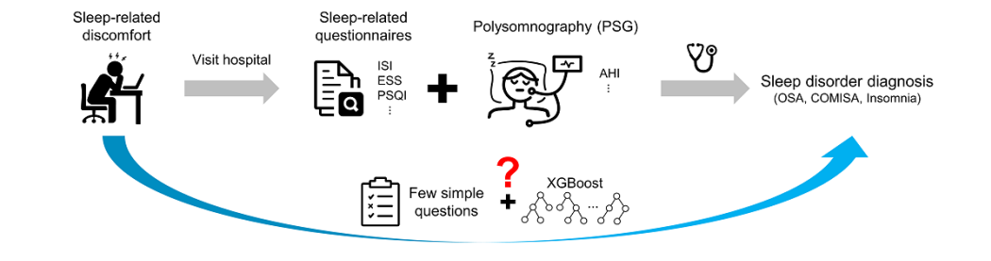
EXISTING SYSTEM

Slide 13
LIMITATIONS
EXISTING SYSTEM
Data availability:
The algorithm is based on data from Korean participants, which limits its applicability to individuals of other races. The authors suggest incorporating data from other races in future work to make the algorithm more widely applicable.
Socioeconomic factors:
The retrospective nature of the study limited the collection of socioeconomic information, such as income level, which may affect the prevalence and severity of sleep disorders. The authors recommend including and analyzing socioeconomic factors in future work to provide a more holistic understanding of sleep disorders and their associations.

Slide 14
Genetic groups and phenotypes:
The study did not specifically emphasize genetic groups or their predispositions to sleep disorders, which may impact the pretest probability and enhance the clinical value of the algorithm. The authors suggest incorporating additional information to identify phenotypes of patients or genetic groups with different predispositions to OSA, COMISA, and insomnia in future work.
Mild OSA:
The apnea-hypopnea index (AHI) is the combined average number of apneas and hypopneas that occur per hour of sleep. Apnea: This is when you stop breathing while asleep or have almost no airflow. hypopneas when your breathing is reduced and you're not taking in enough oxygen
The study used AHI≥15 per hour as the cut-off for OSA and did not consider mild OSA, which may affect many people with insomnia symptoms3. The authors propose developing a screening tool that can distinguish mild OSA from insomnia and COMISA in future work.

Slide 15
PROPOSED SYSTEM
The proposed system uses the Machine Learning algorithms to predict the sleep disorder along with the level of severity and the diagnosis of disorder.
Different machine learning models of classification , ensemble learning of different models like Logistic Regression,SVM,XGBoost,Multi-Lable Classification,CAT Boost models are used and the best mode is chosen by comparing all the accuracies and losses of these machine learning models.
Finally, to deploy the system using Streamlit Cloud for Sleep Disorder Prediction and Diagnosis.

Slide 16
REQUIREMENTS
Software Requirements | Used Version
Google Colab | 3.7
Visual Studio Code | 1.72.2
Hardware Requirements | Used Version
Processor | Intel(R) Core(TM) i7-1065G7 CPU
RAM | 8.00GB
HardDisk | 512 GB

Slide 17
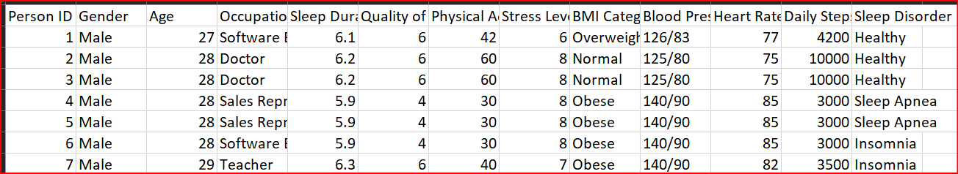
DATA COLLECTION
Dataset Description
a. Type of dataset: Combination of Numerical Data, Categorical Data. b. Sleep Disorders: Insomnia, Sleep Apnea, Healthy.
c. Dataset Size: Dataset size (rows, columns): (374,13)
Sample Dataset

Slide 18
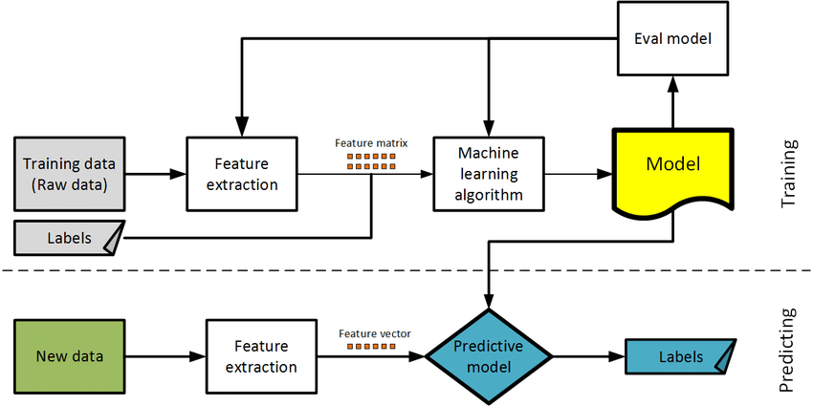
SYSTEM OVERVIEW
Insomnia
Sleep Apnea
Predicting Sleep Disorder
Healthy
Predicting Risk level of Sleep Disorder
High
Predict
output
Moderate
Predicting probability of effecting Sleep Disorder
Suggesting
Self-care Therapy
Supervised Learning Models

Slide 19
REFERENCES
[1] Ha, Seokmin, et al. "Predicting the Risk of Sleep Disorders Using a Machine Learning–Based Simple Questionnaire: Development and Validation Study." Journal of medical Internet resaearch 25 (2023): e46520.
[2] Han, H., Oh, J. Application of various machine learning techniques to predict obstructive sleep apnea syndrome severity. Sci Rep 13, 6379 (2023). https://doi.org/10.1038/s41598-023-33170-7
[3] Han, H., Oh, J. Application of various machine learning techniques to predict obstructive sleep apnea syndrome severity. Sci Rep 13, 6379 (2023). https://doi.org/10.1038/s41598-023-33170-7
[4] Wongsirichot, T. and Hanskunatai, A., 2017. A classification of sleep disorders with optimal features using machine learning techniques. Journal of Health Research, 31(3), pp.209-217.
[5] Korpinen, L., and H. Frey. "Sleep Expert—an intelligent medical decision support system for sleep disorders." Medical Informatics 18.2 (1993): 163-170.

Slide 20
[6] Xu, Shuting, et al. "A review of automated sleep disorder detection." Computers in Biology and Medicine 150 (2022): 106100.
[7] Ankitha, V., et al. "Literature review on sleep APNEA analysis by machine learning algorithms using ECG signals." Journal of Physics: Conference Series. Vol. 1937. No. 1. IOP Publishing, 2021.
[8] Kemidi, M., Marur, D. R., & Chantigari, V. K. R. (2023). Detection and Classification of Obstructive Sleep Apnea Disorders: A Comparative Analysis of Various Deep Machine Learning Classifiers. Revue d'Intelligence Artificielle, 37(1).
[9] Cheng, Y. H., Lech, M., & Wilkinson, R. H. (2023). Simultaneous Sleep Stage and Sleep Disorder Detection from Multimodal Sensors Using Deep Learning. Sensors, 23(7), 3468.
[10] Javeed, Ashir, et al. "Predictive power of XGBoost_BiLSTM model:a machine-learning approach for accurate sleep apnea detection using electronic health data." International Journal of Computational Intelligence Systems 16.1 (2023): 188.

Slide 21
[11] Learning, M. U. S. M. (2020). Obstructive sleep apnea: a prediction model using supervised machine learning method. The Importance of Health Informatics in Public Health during a Pandemic, 272, 387.
[12] Jain, Gunjit. Sleep Apnea detection using Deep Learning Methodologies. Diss. Dublin, National College of Ireland, 2022.
[13] Karimi Moridani M, Hajiali A. Automated sleep stage detection based on recurrence quantification analysis using machine learning. Journal of applied research on industrial engineering. 2022 Oct 1;9(4):409-26.
[14] Arslan, R. S. (2023). Sleep disorder and apnea events detection framework with high performance using two-tier learning model design. PeerJ Computer Science, 9, e1554.
[15] Ramachandran, Anita, and Anupama Karuppiah. "A survey on recent advances in machine learning based sleep apnea detection systems." Healthcare. Vol. 9. No. 7. MDPI, 2021.

